Slide 1


PlushyShop
-BOUALAVONG Laurent
-BOSCHER Cyprien
-VIGNE Enzo

Slide 2

What is PlushyShop ?
PlushyShop seeks to provide plush products from the best possible materials with environmentally friendly production methods.
These plushies aim to represent the best of what some people like, it can be their favorite animal as well as their favorite manga character, so they will embody a decoration of the same kind as figurines.

Slide 3
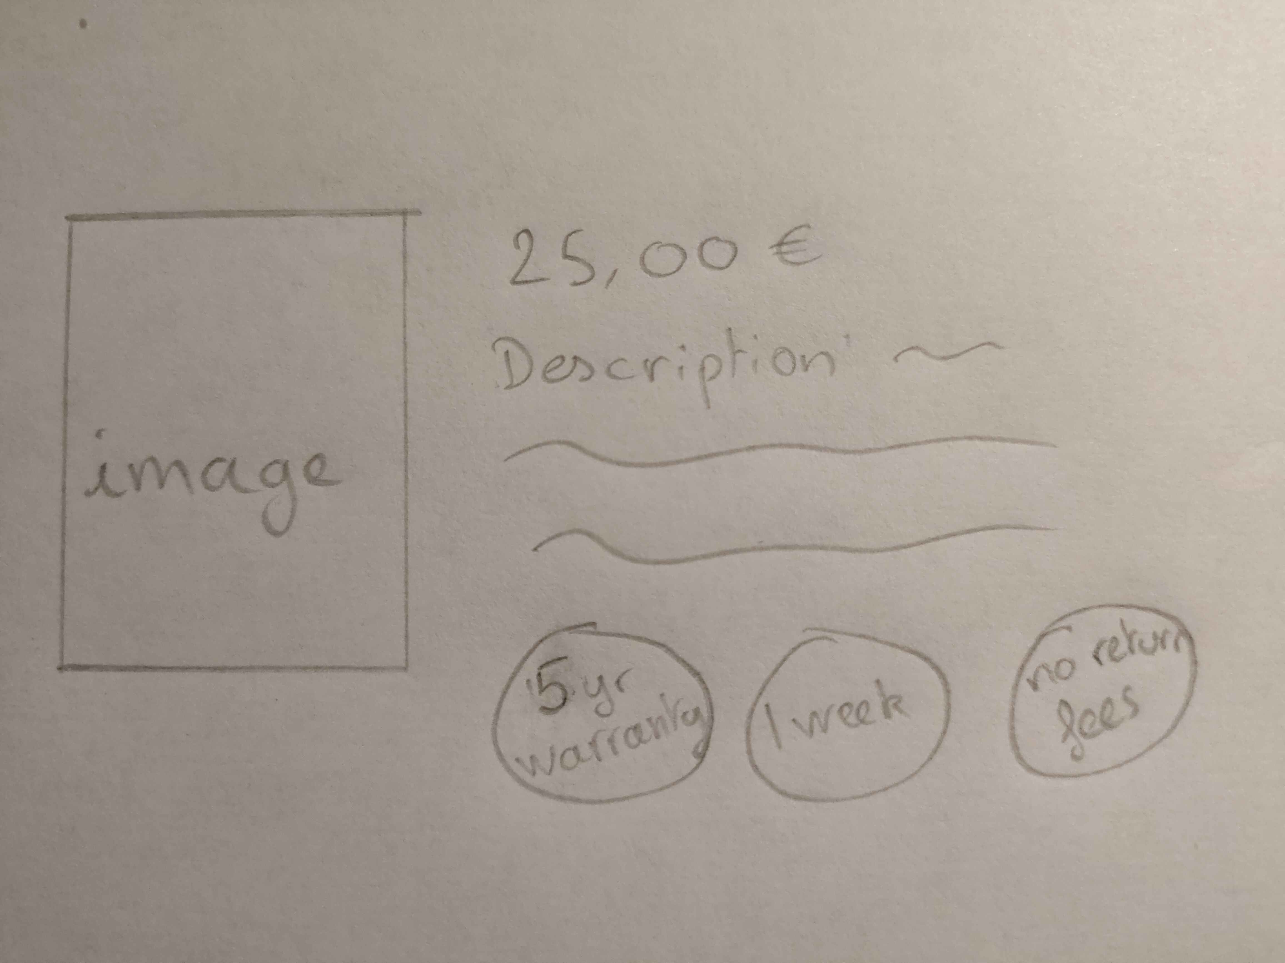
Our services
-Delivery all over Europe
With a maximum delay of a week
-No additional return fees.
Furthermore all our product are
guaranteed for 5 years.

Slide 4

Our requirements
The website have to be as welcoming as possible, that’s why we would like pastels colors.
Its also very important to get a clean and simple website

Slide 5
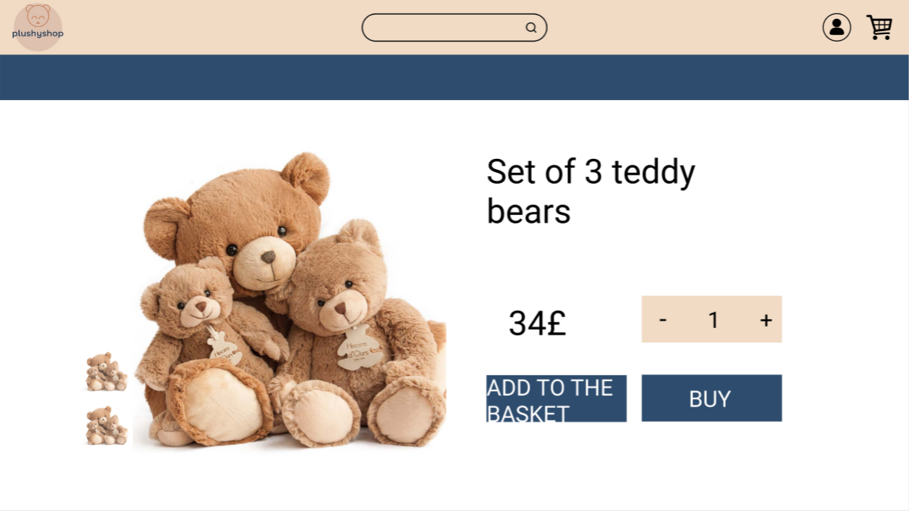
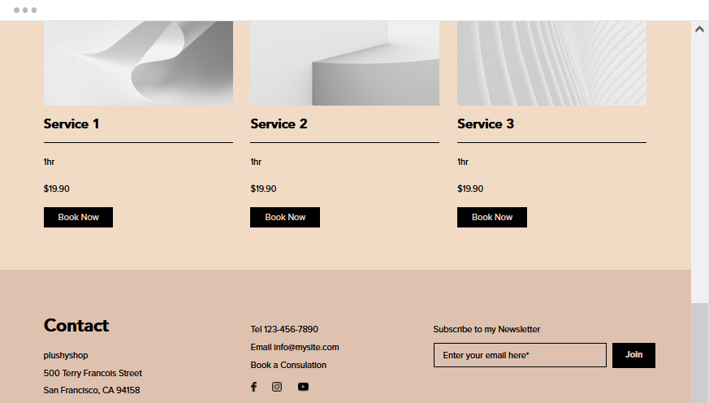
-Navigation bar
-Footer
-Others

Slide 6
Other features
-limited edition plushies for most loyal custommers.
We also plan to produce for companies that will
have the possibility to contact us, it would then be
possible to provide personalized plush on an exceptional basis.

Slide 7
Conclusion
We want our site to be as easy to use as possible
while remaining pleasant to look at and interractive.
We also want our site to highlight our values
(product quality, respect for the environment and use of good materials)

Slide 8
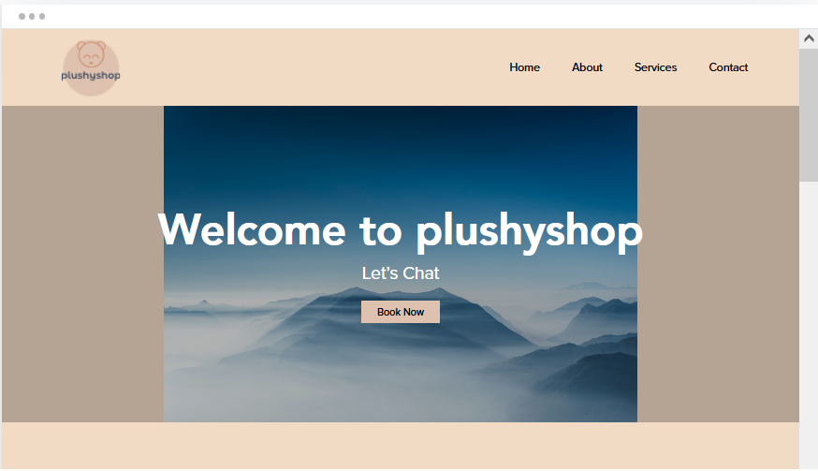
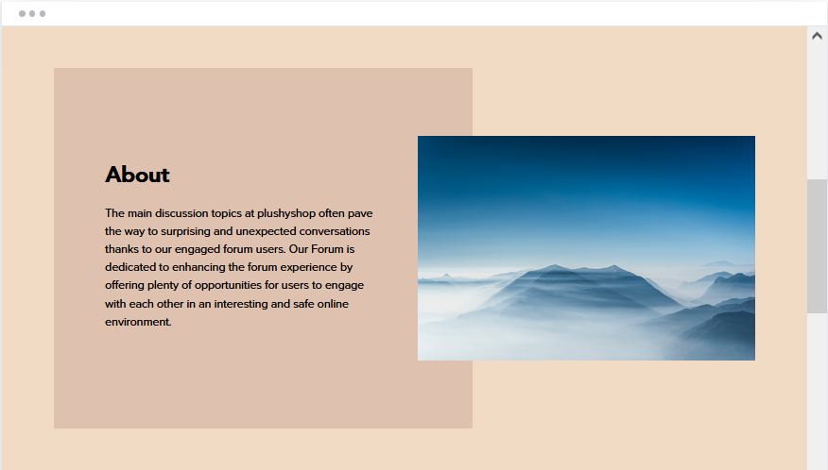
Other examples

